Slide 1


Unit-03 Introduction to Machine Learning
Introduction to Advanced Technologies (2305CS302)
CO3 : At the end of this course, students will be able to,
classify machine learning algorithm and artificial neural networks.
Prof. Vaseem Ghada
Master of Computer Application
vaseem.ghada@darshan.ac.in
9879531513

Slide 2

Outline
Introduction to Machine Learning
Working of Machine Learning
Machine Learning Terminology
Life Cycle of Machine Learning
Classification of Machine Learning
Supervised Learning
Unsupervised Learning
Reinforcement Learning
Tools & Technology for Machine Learning
Overview of Artificial Neural Networks
Looping

Slide 3
Introduction to Machine Learning
Section - 1

Slide 4








What is Human Learning?
Human beings learn from the past experiences.
Human beings receive training at early stage of life to
walk, speak, think, etc.

Slide 5

ML System
Data
Output
Traditional Programing
Computer
Program
Data
Computer
Program
Machine Learning
Output

Slide 6
Big Picture
Artificial intelligence
A technique which enables machines to mimic human behaviour
Artificial intelligence
Machine Learning
Subset of Al technique which use statistical methods to enable machines to improve with experience
Machine Learning
Deep Learning
Subset of ML which make the computation of multi-layer neural network feasible
Deep Learning

Slide 7
Definition
Tom M. Mitchell (1997)
A computer program is said to learn from experience E with respect to some class of tasks and performance measure P, if its performance at tasks in T, as measured by P, improves with experience E
Arthur Samuel (1959)
Machine learning is the field of study that gives computers the ability to learn without being explicitly programmed.
Ian Goodfellow, Yoshua Bengio, and Aaron Courville (2016):
Machine learning is the science of getting computers to act without being explicitly programmed, by extracting patterns and insights from data
Ethem Alpaydin (2004):
Machine learning develops algorithms that can learn from and make predictions on data.
Kevin P. Murphy (2012)
Machine learning is a set of methods that can automatically detect patterns in data and then use the uncovered patterns to predict future data or other outcomes of interest

Slide 8
When to Use Machine Learning ?
When the Problem Is Too Complex for Coding
In a situation where the problem is so complex or big that you cannot hope to write all the rules to solve it and where a partial solution is viable and interesting, you can try to solve the problem with machine learning.
When the Problem Is Constantly Changing
Some problems may continuously change with time so that the programming code must be regularly updated.
That results in the frustration of software engineers working on the problem, an increased chance of introducing errors, diﬃculties of combining “previous” and “new” logic, and significant overhead of testing and deploying updated solutions.
When It Is a Perceptive Problem
Today, it’s hard to imagine someone trying to solve perceptive problems such as speech, image, and video recognition without using machine learning

Slide 9
When to Use Machine Learning
When It Is an Unstudied Phenomenon
If we need to be able to make predictions of some phenomenon that is not well-studied scientifically, but examples of it are observable, then machine learning might be an appropriate.
When It Is Cost-Effective
The cost of training the model includes human labor and, in some cases, the expensive hardware needed to train deep models.
Model maintenance includes continuously monitoring the model and collecting additional data to keep the model up to date

Slide 10
When to Use Machine Learning
Every action of the system or a decision made by it must be explainable.
Every change in the system’s behavior compared to its past behavior in a similar situation must be explainable.
The cost of an error made by the system is too high.
Getting the right data is too hard or impossible.
You can solve the problem using traditional software development at a lower cost.
A simple heuristic would work reasonably well.
You build a system that will not have to be improved frequently over time.

Slide 11
ML Applications
Medical Diagnosis
Stock Market Trading
Image Recognition
Speech Recognition
Online Fraud Detection
Email Spam Detection
Traffic Prediction
Product recommendation
Language Translation
Self Driving Car

Slide 12
Working of Machine Learning
Section - 2

Slide 13
Working of ML
Machine learning is a sub-discipline of Artificial Intelligence.
Machine Learning is the field of study that gives computers the capability to learn without being explicitly programmed.
Task Done
Data
Start
No Error
Evaluate
Study the problem
Train ML Algo
Error
Analyze
Error

Slide 14
Life Cycle of Machine Learning
Section - 3

Slide 15
Machine Learning Project life cycle
business analyst & data analyst
data engineer & data labeler
data analyst
Goal Definition
Data collection & preparation
Feature engineering
Model training
Model evaluation
Business problem
Model maintenance
Model monitoring
Model serving
Model Deployment
data analyst & data labeler
DevOps
Machine Learning

Slide 16
Machine Learning Project life cycle
Problem Definition
Define the business or research problem.
Identify objectives, success metrics, and constraints.
Understand the potential impact of ML on solving the problem.
Data Collection & Preparation
Gather relevant data from various sources (databases, APIs, web scraping, etc.).
Ensure data aligns with the problem's needs in terms of scope, quality, and scale.
Clean the data: Handle missing values, remove duplicates, and address inconsistencies.
Normalize or standardize features to ensure compatibility with ML algorithms.
Split the dataset into training, validation, and testing subsets.
Perform exploratory data analysis (EDA) to understand data distributions and patterns.
Feature Engineering
Select or create meaningful features from raw data to improve model performance.
Techniques include: Feature selection , Feature transformation , Feature creation

Slide 17
Machine Learning Project life cycle
Model Training
Train the model using the training dataset.
Optimize model parameters using techniques like gradient descent.
Monitor performance using metrics like accuracy, precision, recall, etc.
Model Evaluation
Evaluate the model on the validation dataset to tune hyperparameters.
Assess performance using appropriate metrics accuracy, precision, recall, etc.
Perform cross-validation for robust evaluation.
Model Deployment
Integrate the trained model into production environments.
Options for deployment:
Batch processing (offline).
Real-time inference (APIs, cloud services).

Slide 18
Machine Learning Project life cycle
Model Serving
Ensures the model is operational and accessible to users.
Serving in Batch Mode - In batch serving, predictions are generated for a large dataset all at once and stored for later use.
In on-demand serving, predictions are generated dynamically in response to a specific user request.
Model Monitoring
Model Monitoring detects performance issues or changing data distributions.
The process of tracking a deployed model’s performance, accuracy, and reliability in production.
Model Maintenance
Model Maintenance addresses issues found during monitoring and improves the model's accuracy and reliability.
Activities aimed at ensuring the model remains accurate, relevant and efficient over time.

Slide 19
Machine Learning Terminology
Section - 4

Slide 20



ML Terminology
A method, function, or series of instructions used to generate a machine learning model.
Examples: include linear regression, decision trees, support vector machines, and Naïve Bayes.
A mathematical representation of a real-world process learned from data.
A model defines the relationship between features and label.
Models are created/learned when you train an algorithm on a dataset.
Example: A spam filter
Algorithm
Model

Slide 21


ML Terminology
With respect to a dataset, a feature represents an attribute and value combination.
A Feature is the input used for prediction or classification.
Input variables for the model
Example : "email length" and "presence of keywords”
In supervised learning, a label is the "answer" or "result" portion of an Model.
Target outcomes.
Example: "Spam" or "Not Spam"
Feature
Label

Slide 22


ML Terminology
Data used to teach the model .
Training means creating or learning the model.
During training the model is given labeled examples.
Training enables the model to gradually learn the relationships between features and label.
Example: set of emails labeled as spam or not for training.
Data used to evaluate the model.
Testing means applying the trained model to unlabeled examples.
That is, you use the trained model to make useful predictions.
Example: unseen emails
Training
Testing

Slide 23
Tools & Technology for ML
Section – 5

Slide 24
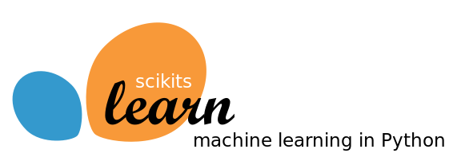
Tools used for Machine Learning : Scikit-learn
The Scikit-learn library is one of many Scikit libraries that build on the capabilities provided by NumPy and SciPy to allow Python developers to perform domain specific tasks.
Scikit-learn library focuses on data mining and data analysis, it provides access to following sort of functionality:
Classification
Regression
Clustering
Dimensionality reduction
Model selection
Pre-processing
Scikit-learn is the most important library we are going to learn in this subject

Slide 25

Tools used for Machine Learning : Keras and TensorFlow
Keras is an application programming interface (API) that is used to train deep learning models.
An API often specifies a model for doing something, but it doesn’t provide an implementation.
TensorFlow is an implementation for the keras, there are many other implementations for the keras like
Microsoft’s cognitive Toolkit, CNKT
Theano

Slide 26
Classes in Scikit-learn
Understanding how classes work is an important prerequisite for being able to use the Scikit-learn package appropriately.
Scikit-learn is the package for machine learning and data science experimentation favored by most data scientists.
It contains wide range of well-established learning algorithms, error functions and testing procedures.
Install : conda install scikit-learn
There are four class types covering all the basic machine-learning functionalities,
Classifying
Regressing
Grouping by clusters
Transforming data

Slide 27
Choosing a correct algorithm in Scikit-learn
Get more data
>50
samples
Start
Predicting a category?
Predicting a Quantity?
No
Yes
Not working
Do you have Labeled data?
Clustering
Regression
<100K
samples
<100K
samples
no. of category known
Randomized
PCA
No Algo
SGD
Regressor
Few features are important
Linear SVC
SGD
Classifier
<10K
samples
<10K
samples
<10K
samples
Text data?
KMeans
RidgeRegressor
kernel
approximation
Mini Batch
KMeans
Lasso
Kernel
approximation
Isomap
SVR(kernel=‘linear’)
Spectral
Embedding
ElasticNet
Spectral
Clustering
Mean Shift
Dimensionality
Reduction
Naïve
Bayes
Kneighbors
Classifier
SVC
EnsembleRegressor
Ensemble
Classifiers
GMM
VBGMM
Classification
SVR(kernel=‘rbf’)
LLE

Slide 28
Classification of ML Techniques
Section - 6

Slide 29
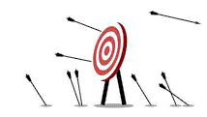

Classification of ML Techniques
Machine Learning
Supervised Learning
Unsupervised Learning
Reinforcement Learning
Task driven / predict value
Data driven / identify clusters
Learn from mistakes

Slide 30
Supervised Learning
Section – 6.1

Slide 31
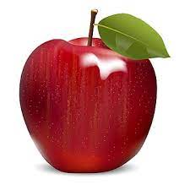
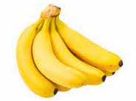
Supervised Learning
Labeled data
???
Apple
Banana
Apple
Prediction
Algorithm
Its an Apple
Banana
Banana
Apple
Apple
Apple
Apple
Training Data Set
Here we Use Label Data to train Classifier (Supervised Learning)

Slide 32
Machine Learning Process for Supervised Learning
Test Data
Model Testing
Collecting data
Cleaning data
Splitting data
Update Parameters
Model Deployment
Train Data
Model Training

Slide 33
Supervised Learning
Also called predictive learning. A machine predicts the class of unknown objects based on prior class-related information of similar objects.
The major motivation of supervised learning is to learn from past information.
A machine needs the basic information to be provided to it. This basic input, or the experience in the paradigm of machine learning, is given in the form of training data.
Example:
Predicting the results of a game
Predicting whether a tumour is malignant or benign
Predicting the price of domains like real estate, stocks, etc.
Classifying texts such as classifying a set of emails as spam or non-spam

Slide 34
Unsupervised Learning
Section – 6.2

Slide 35
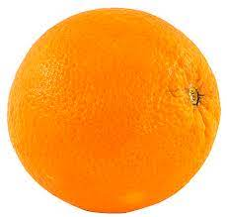
Unsupervised Learning
Input Data
Clustering
Algorithm
Here we don’t use Label Data to train Classifier(Unsupervised Learning)
Finding similarities between data according to the characteristics found in the data and grouping similar data objects into clusters

Slide 36
Unsupervised Learning
Also called descriptive learning. A machine finds patterns in unknown objects by grouping similar objects together.
In unsupervised learning, the objective is to take a dataset as input and try to find natural groupings or patterns within the data elements or records.
Therefore, unsupervised learning is often termed as descriptive model and the process of unsupervised learning is referred as pattern discovery or knowledge discovery.
One critical application of unsupervised learning is customer segmentation.
Clustering is the main type of unsupervised learning. It intends to group or organize similar objects together.
For that reason, objects belonging to the same cluster are quite similar to each other while objects belonging to different clusters are quite dissimilar.
Clustering, Dimensionality Reduction, Density Estimation, Association Rule Learning are the type of unsupervised learning.

Slide 37
Reinforcement Learning
Section – 6.3

Slide 38
Reinforcement Learning
Input Data
Environment
Reward
Best
Action
State
Algo
Selection
Agent
Reinforcement Learning Model

Slide 39
Reinforcement Learning
It use feedback is called a reward, or reinforcement.
1) The agent(decision-maker) observes the current state of the environment(The system or scenario with which the agent interacts.).
2) Based on the state, the agent chooses an action according to its policy(The agent's strategy, mapping states to actions.).
3) The environment responds to the action by:
Transitioning to a new state
Providing a reward.
4) The agent updates its policy using the feedback.
Steps 1–4 repeat, with the goal of maximizing the total reward over time.
Reinforcement learning is like training a dog, where the agent (dog) learns to take actions based on rewards from interacting with its environment.
The key components include the agent (dog), environment (surroundings), state (current situation), action (behavior), and reward (feedback).

Slide 40
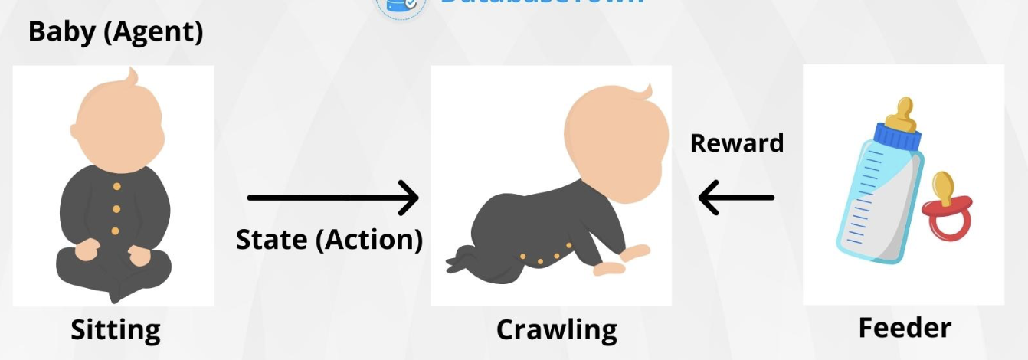
Reinforcement Learning
The dog learns through trial and error, associating positive rewards like treats with correct actions and negative rewards with incorrect ones.
Initially, the dog explores various actions to identify what yields rewards, then exploits this knowledge to consistently perform rewarding actions.
Concepts like positive reinforcement (rewarding good behavior) and shaping (rewarding gradual improvements) are central to both dog training and reinforcement learning.
Ref: https://databasetown.com/basics-of-reinforcement-learning/

Slide 41
Supervised vs. Unsupervised vs. Reinforcement
Supervised Learning | Unsupervised Learning | Reinforcement
Input data is labeled | Input data is unlabeled | Sequential interaction data
Has a feedback mechanism | Has no feedback mechanism | Reward signals
Data is classified based on the training dataset | Assigns properties of given data to classify it | The model learn and updates itself through reward.
Divided into Regression & Classification | Divided into Clustering & Association | No Types
Used for prediction | Used for analysis | Used for Maximize rewards
Algorithms include: decision trees, logistic regressions, support vector machine | Algorithms include: k-means clustering, hierarchical clustering, apriori algorithm | Algorithms include:Q-Learning, Sarsa
A known number of classes | A unknown number of classes | A unknown number of classes

Slide 42
Overview of Artificial Neural Networks
Section - 7

Slide 43
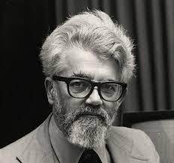
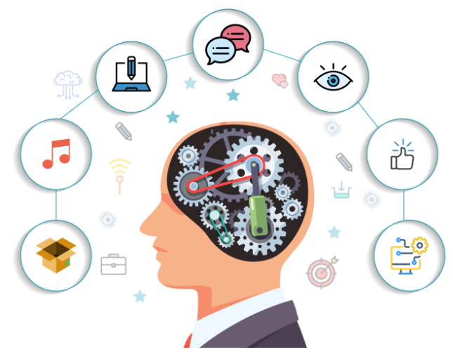
What is Artificial Intelligence?
The term “Artificial Intelligence” was actually coined way back in 1956 by John McCarthy, a professor at Dartmouth.
AI is the science and engineering of making intelligent machines.
AI is a branch of computer science dealing with the simulation of intelligent behavior in computers.
AI is the study of how to make computers do things which, at a moment, people do better.

Slide 44
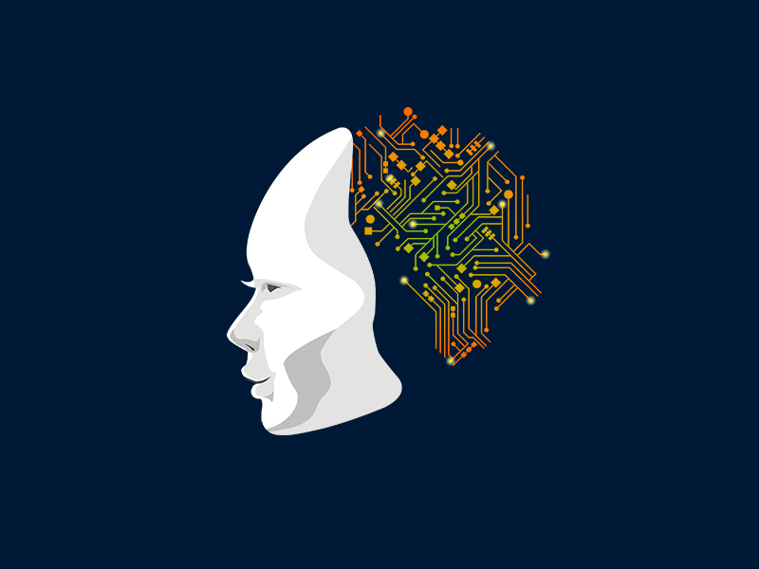
What is Artificial Neural Network?
Artificial Neural Network (ANN) is an efficient computing system whose working principle is borrowed from the analogy of biological neural networks of human brain.
The human brain is a highly complex, nonlinear, and parallel information-processing system.
It has the capability of organizing neurons so as to perform certain computations (e.g. pattern recognition, perception, and motor control) many times faster than the fastest digital computer.
A brain has great structure and the ability to build up its own rules through what we usually refer to as experience.

Slide 45
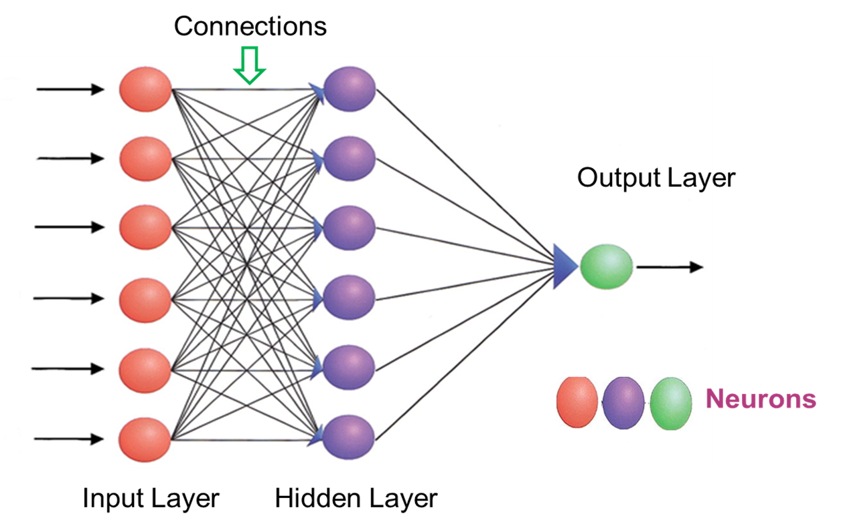
How ANN works?
The network starts with an input layer that receives input in the form of data.
The lines connected to the hidden layers are called weights, and they add up on the hidden layers.
Each dot in the hidden layer processes the inputs, and it puts an output into the next hidden layer and lastly, into the output layer.
A neural network is a system of hardware or software patterned after the operation of neurons in the human brain.
Neural networks, also called artificial neural networks, are ways of achieving deep learning.

Slide 46
Characteristics of Artificial Neural Network
It is basically a mathematical model.
It contains huge number of interconnected processing elements called neurons to do all operations.
Information stored in the neurons are basically the weighted linkage of neurons.
The input signals arrive at the processing elements through connections and connecting weights.
It has the ability to learn, recall and generalize from the given data by suitable assignment and adjustment of weights.
The collective behavior of the neurons describes its computational power, and no single neuron carries specific information.

Slide 47
Example of Artificial Neuron Network
Let’s take the below network with the given input and calculate the net input neuron and obtain the output of the neuron Y with activation function as binary sigmoidal.
The input has 3 neurons x1, x2 and x3, and single output Y.
The weights associated with the inputs are: {0.2, 0.1, -0.3}
Inputs= {0.3, 0.5, 0.6}
Let’s take the below network with the given input and calculate the net input neuron and obtain the output of the neuron Y with activation function as binary sigmoidal.
The input has 3 neurons x1, x2 and x3, and single output Y.
The weights associated with the inputs are: {0.2, 0.1, -0.3}
Inputs= {0.3, 0.5, 0.6}
0.4
x1
0.2
0.3
x2
Y
0.7
x3
-0.3

Slide 48
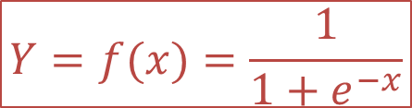
Example of Artificial Neuron Network
The weighted sum of Inputs means the “product of the weight of input and value of input” summed together for all inputs.
Net input ={x1*w1+x2*w2+ x3*w3}
Net input = (0.4*0.2) + (0.3*0.1) + (0.7*-0.3)
Net input X = -0.07
Output for Binary Sigmoidal
The weighted sum of Inputs means the “product of the weight of input and value of input” summed together for all inputs.
Net input ={x1*w1+x2*w2+ x3*w3}
Net input = (0.4*0.2) + (0.3*0.1) + (0.7*-0.3)
Net input X = -0.07
Output for Binary Sigmoidal
$$Y=f(x)=\frac{1}{1+e^{−x}}$$
0.4
x1
0.2
0.3
x2
0.1
Y
0.467
0.7
x3
-0.3

Slide 49
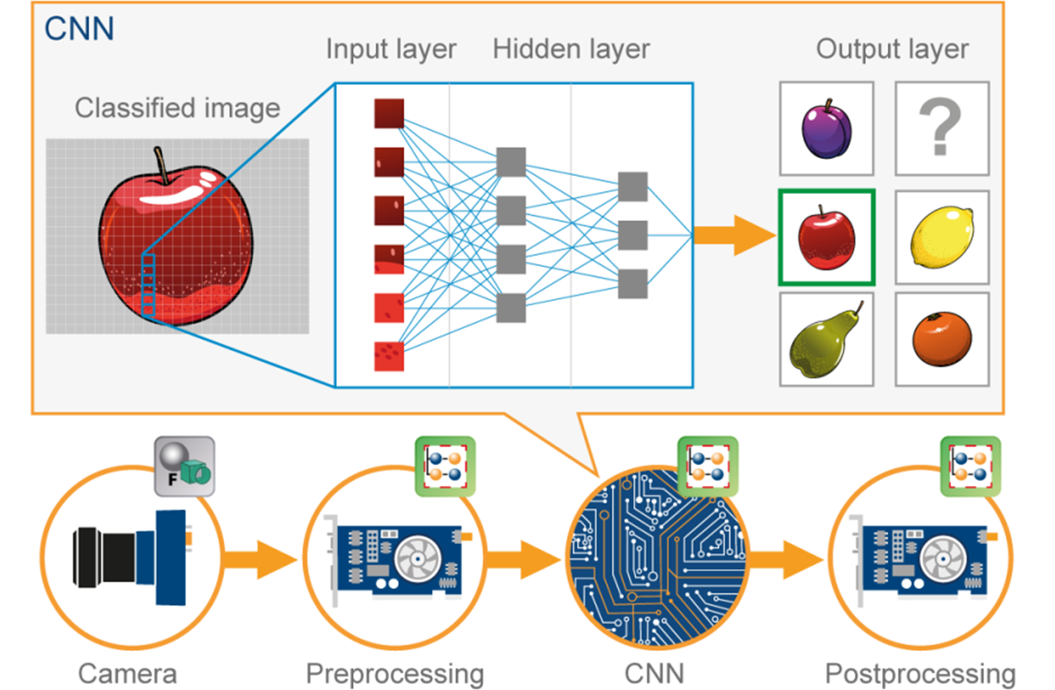
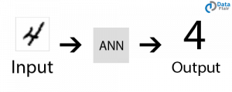
Applications of ANN
Image Processing and Character recognition:
ANN has an ability to take in a lot of inputs, process them to infer hidden as well as complex, non-linear relationships, ANNs are playing a big role in image and character recognition.
Character recognition like handwriting has lot of applications in fraud detection (e.g. bank fraud) and even national security assessments.
Image recognition is an ever-growing field with widespread applications from facial recognition in social media, cancer detention in medicine to satellite imagery processing for agricultural and defense usage.

Slide 50
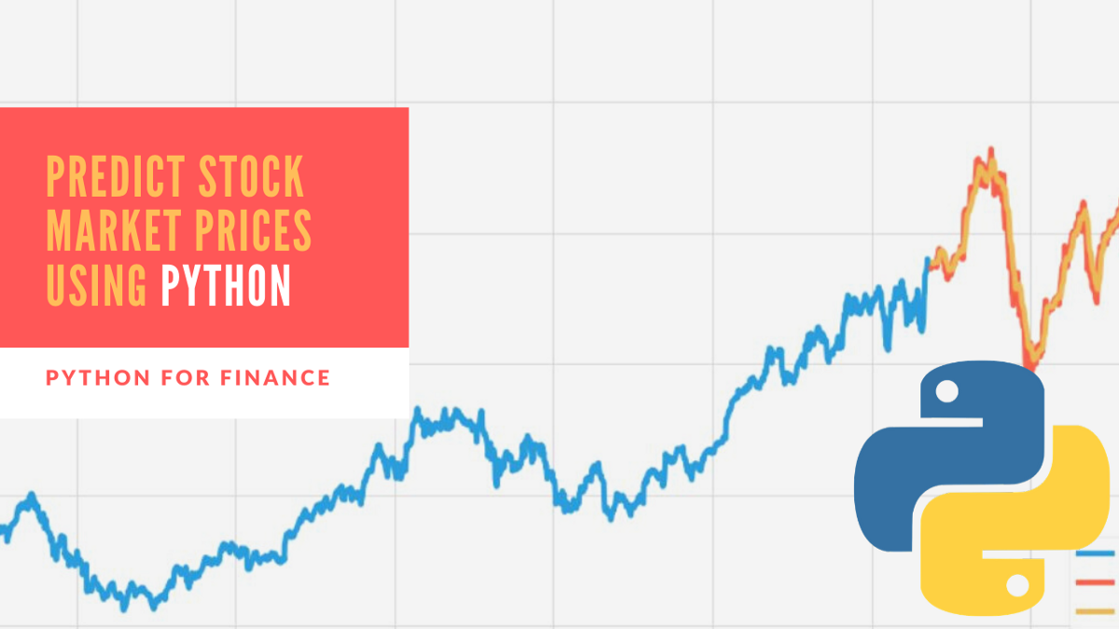
Applications of ANN
Forecasting:
Forecasting is required extensively in everyday business decisions (e.g. sales, financial allocation between products, capacity utilization), in economic and monetary policy, in finance and stock market.
More often, forecasting problems are complex, for example, predicting stock prices is a complex problem with a lot of underlying factors.

Slide 51
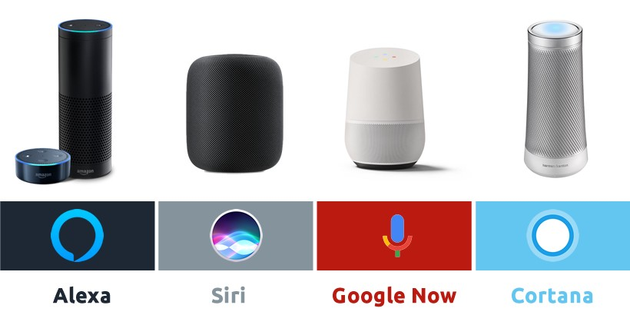
Applications of ANN
Speech Recognition:
Speech recognition has many applications, such as home automation, mobile telephony, virtual assistance, hands-free computing, video games, and so on. Neutral networks are widely used in this area.
We can say its a direct example of applications in virtual assistants or chatbots.
Nowadays, Google smart home, Alexa, Siri, Google assistance or Cortana are known to most of us.

Slide 52
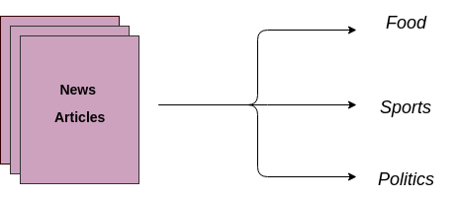
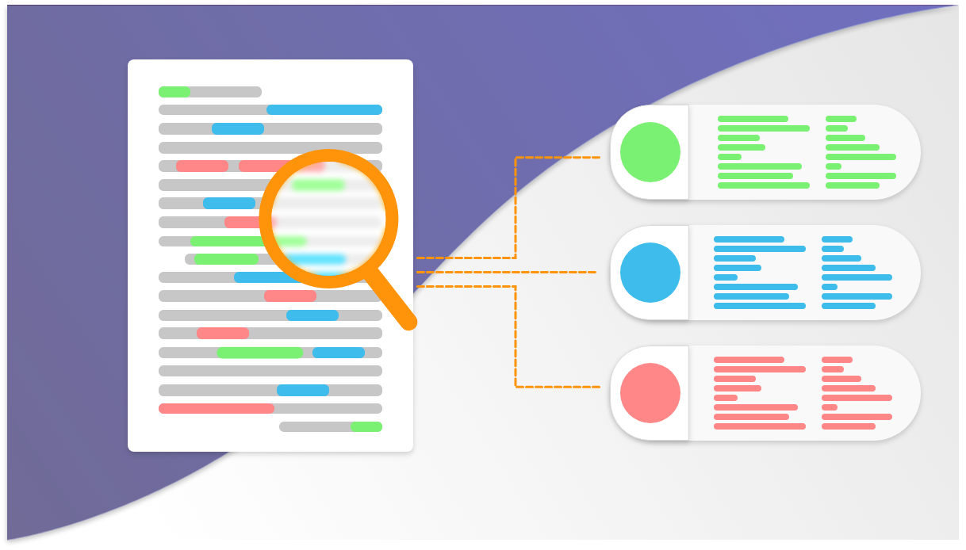
Applications of ANN
Text Classification and Categorization:
Text classification is an essential part of document search and filtering, online web searches and language identification and sentiment analysis.
Neural networks are actively used for this kind of task. Named entity recognition and parts of speech tagging are some of the application that comes under the domain of Natural Language Processing (NLP).
The widely used models are Recurrent Neural Networks (RNN) and Long-Short Term Memory (LSTM) networks. Though, CNN is also used for some of the applications.

Slide 53
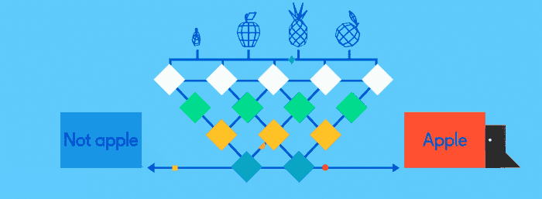
Applications of ANN
Image classification or labelling:
Convolution Neural Network or Feed-forward neural network with back-propagation is generally used for image classification. A model is selected based on the dataset for training and features of interest.
Transfer learning can be done using any pre-trained model if the dataset of your problem is similar to the dataset of the pre-trained model that you are choosing.
There are many pre-trained image classification models that are trained on millions of images of different hundreds and thousands of classes. Some of the models are ResNet, GoogLeNet, InceptionV3, VGG16, ImageNet and many more are available.
Image Source: https://towardsdatascience.com/activation-functions-neural-networks-1cbd9f8d91d6

Slide 54

Applications of ANN
Language Generation and Document Summarization:
Natural Language Generation and Paraphrasing and document summarization are widely used to generate the documents and summarize multi-documents.
Their applications can be found in generating text-based reports from data tables, automated reports writing, summarizing medical reports, generating stories and novels, etc.

Slide 55
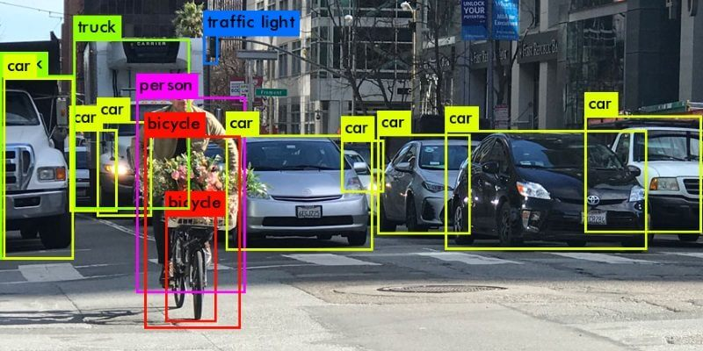
Applications of ANN
Object detection:
Object detection from images is widely used to detect any object and classify it based on that.
It needs large training dataset with all the coordinates of the object of interest clearly specified. The widely used object detection models are YOLO (You Only Look Once) and SSD (Single Shot Object Detectors).

Slide 56
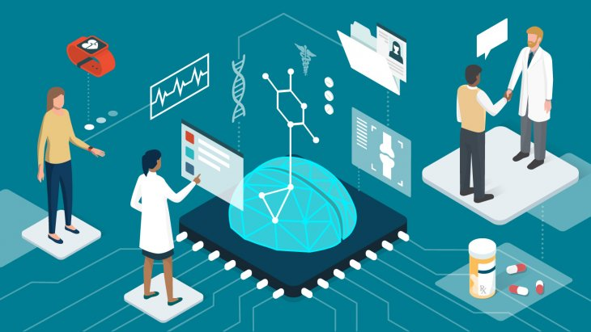
Applications of ANN
Healthcare:
Artificial Neural Networks are used in Oncology to train algorithms that can identify cancerous tissue at the microscopic level at the same accuracy as trained physicians.
Various rare diseases may manifest in physical characteristics and can be identified in their premature stages by using Facial Analysis on the patient photos.
The full-scale implementation of Artificial Neural Networks in the healthcare environment can only enhance the diagnostic abilities of medical experts and ultimately lead to the overall improvement in the quality of medical care all over the world.

Slide 57
Introduction to Advanced Technologies (2305CS302)
Prof. Vaseem Ghada
Master of Computer Application
vaseem.ghada@darshan.ac.in
9879531513

